Slide 1
Academy Lab Projects – Showcase
Lê Đức Long (23010016)
Project building a Data Pipeline to Support Analyzing Clickstream Data with AWS
20/6/2025
Notes:
For Educators: You can use this template to help your students effectively present and communicate their project to a broader audience. Your students can also use this presentation as a portfolio of their work to demonstrate their cloud skills.
The presentation structure is listed below. The total time may vary depending on the activity you want to conduct. For example, you may want your students to provide high-level walkthrough of their final solutions versus deep-dive into why or how they chose certain services and the steps of building their architectures.
Suggested timing for a 15-minute presentation:
Introduction – 30 seconds
Business scenario overview – 1 minute
Solution overview – 5 minutes
Architecture diagram of the solution – 2 minutes
Demo – 5 minutes
Lessons learned – 1.5 minutes

Slide 2
Business scenario overview
Vấn Đề
AnyCompany Café là một chuỗi cửa hàng bán cà phê và món tráng miệng qua website, với nhiều chi nhánh trên khắp thế giới. Họ muốn hiểu rõ hơn về hoạt động kinh doanh thông qua dữ liệu tương tác của người dùng trên website (clickstream). Mục tiêu là phân tích xu hướng truy cập để ra quyết định đầu tư hiệu quả hơn, ví dụ như lựa chọn khu vực mở rộng thêm chi nhánh, hướng đầu tư cho một sản phẩm.
AnyCompany Café đã thuê công ty tư vấn của bạn để thực hiện dự án này. Tôi với vai trò là chuyên gia tích hợp dữ liệu, làm việc cùng đội ngũ kỹ sư dữ liệu, nhà phân tích và lập trình viên web.
Dữ liệu clickstream được lấy từ log website — ghi lại từng hành động nhấp chuột của khách hàng tiềm năng khi truy cập website.
Notes:
Define the problem or opportunity that you are addressing. Include pictures, figures, and statistics to help the audience better conceptualize the problem or opportunity.
Specify who your users or customers are and what pain points they are experiencing.
For example: “Users complain that the student admissions department website is too slow and isn’t always available.”
Also, list any specific business requirements that you are addressing.
For example: “Improve the experience for users. The web application can be deployed to the AWS Cloud. The application must be highly available, scalable, load balanced, secure, and performant architecture that can support thousands of users.“
Note:
An above-bar overview succinctly defines the problem and opportunity statement. For example: “Customers with media files, such as retail companies, need an easy and cost-effective way to analyze photos and videos of their inventory.”
A below-bar overview is too verbose, technical, or not specific. For example: “The most common media files are .jpg and .mp4. Companies have media files of their inventory.”

Slide 3
Business scenario overview
Giải pháp và yêu cầu kĩ thuật cho vấn đề
Thiết kế và tối ưu chi phí giải pháp trước khi triển khai.
Đảm bảo hệ thống hoạt động chính xác và ổn định.
Biến đổi (transform) dữ liệu để phục vụ phân tích.
Thu thập dữ liệu truy cập từ file access_log của máy chủ web.
Sử dụng dữ liệu mô phỏng (simulated) để thực hiện phân tích.
Phân tích và trực quan hóa dữ liệu.
Tạo ra các insight hữu ích phục vụ cho chiến lược phát triển và marketing.
Notes:
Define the problem or opportunity that you are addressing. Include pictures, figures, and statistics to help the audience better conceptualize the problem or opportunity.
Specify who your users or customers are and what pain points they are experiencing.
For example: “Users complain that the student admissions department website is too slow and isn’t always available.”
Also, list any specific business requirements that you are addressing.
For example: “Improve the experience for users. The web application can be deployed to the AWS Cloud. The application must be highly available, scalable, load balanced, secure, and performant architecture that can support thousands of users.“
Note:
An above-bar overview succinctly defines the problem and opportunity statement. For example: “Customers with media files, such as retail companies, need an easy and cost-effective way to analyze photos and videos of their inventory.”
A below-bar overview is too verbose, technical, or not specific. For example: “The most common media files are .jpg and .mp4. Companies have media files of their inventory.”

Slide 4
Solution overview
High-level Description (Mô tả tổng quan)
Giải pháp xây dựng một pipeline phân tích dữ liệu clickstream từ website bán hàng của AnyCompany Café để cung cấp cái nhìn sâu sắc về hành vi người dùng. Hệ thống sử dụng CloudWatch để thu thập và phân tích log, Cloud9 để vận hành ứng dụng web và lưu log truy cập. Dữ liệu log được lưu trữ ở Amazon S3 và truy vấn bằng CloudWatch Logs Insights. Cuối cùng, dữ liệu được trực quan hóa trên CloudWatch Dashboard để hỗ trợ ra quyết định.
Notes:
Explain at a high level what you have built.
For example: “I built a web application for a company to host their blog.“
Talk about why you chose certain parts of the solutions and any tradeoffs that you made. Focus on how you designed the solutions and how you applied the AWS Well-Architected Framework as part of the process (AWS Well-Architected Framework: https://docs.aws.amazon.com/wellarchitected/latest/framework/welcome.html).
For example: “I configured load balancers and auto scaling to make the application highly available and reliable.”
Include the use cases that you are addressing. Think about who your users are and how they would want to interact with your solution to solve their problem.
For example: “Users can view, upload, edit, and delete blog posts. Administrators can approve blog posts.”
Talk about the use cases that you addressed as part of the minimum viable product (MVP) that you scoped and built.
Note:
An above-bar description is concise and includes the most important benefits. For example: “The solution allows customers to quickly upload, store, and search large catalogs of images and videos in Amazon S3.”
A below-bar description is too detailed or not specific. For example: “Our solution analyzes media files.”

Slide 5
Solution overview
Design Considerations (Các yếu tố cần cân nhắc trong thiết kế)
Hiệu quả chi phí: Sử dụng dịch vụ có mức giá thấp như CloudWatch Logs thay vì các dịch vụ dữ liệu thời gian thực cao cấp hơn.
Dễ triển khai và tích hợp: Cloud9 (chạy trên EC2) tích hợp tốt với Apache để host web app, và dễ cấu hình gửi log sang CloudWatch thông qua agent.
Bảo mật và phân quyền: Sử dụng IAM Role giới hạn truy cập, chỉ cho phép EC2 ghi vào CloudWatch và S3.
Khả năng mở rộng: Có thể dễ dàng mở rộng sang nhiều thành phố/quốc gia do giải pháp chạy hoàn toàn trên đám mây.
Truy cập dữ liệu nhanh chóng: Dùng CloudWatch Logs Insights để truy vấn log gần như theo thời gian thực.
Notes:
Explain at a high level what you have built.
For example: “I built a web application for a company to host their blog.“
Talk about why you chose certain parts of the solutions and any tradeoffs that you made. Focus on how you designed the solutions and how you applied the AWS Well-Architected Framework as part of the process (AWS Well-Architected Framework: https://docs.aws.amazon.com/wellarchitected/latest/framework/welcome.html).
For example: “I configured load balancers and auto scaling to make the application highly available and reliable.”
Include the use cases that you are addressing. Think about who your users are and how they would want to interact with your solution to solve their problem.
For example: “Users can view, upload, edit, and delete blog posts. Administrators can approve blog posts.”
Talk about the use cases that you addressed as part of the minimum viable product (MVP) that you scoped and built.
Note:
An above-bar description is concise and includes the most important benefits. For example: “The solution allows customers to quickly upload, store, and search large catalogs of images and videos in Amazon S3.”
A below-bar description is too detailed or not specific. For example: “Our solution analyzes media files.”

Slide 6
Solution overview
Use Cases (Tình huống sử dụng thực tế)
Phân tích hành vi khách hàng: Thống kê số lượt truy cập từng trang (menu, đặt hàng...), phân bố theo thành phố.
Tối ưu chiến dịch quảng cáo: Nhận biết vùng có nhiều người truy cập để tập trung ngân sách quảng cáo.
Lựa chọn vị trí mở quán mới: Phân tích dữ liệu truy cập để đưa ra quyết định mở thêm chi nhánh.
Theo dõi hệ thống web: Sử dụng dashboard để theo dõi tình trạng hoạt động của web server theo thời gian.
Notes:
Explain at a high level what you have built.
For example: “I built a web application for a company to host their blog.“
Talk about why you chose certain parts of the solutions and any tradeoffs that you made. Focus on how you designed the solutions and how you applied the AWS Well-Architected Framework as part of the process (AWS Well-Architected Framework: https://docs.aws.amazon.com/wellarchitected/latest/framework/welcome.html).
For example: “I configured load balancers and auto scaling to make the application highly available and reliable.”
Include the use cases that you are addressing. Think about who your users are and how they would want to interact with your solution to solve their problem.
For example: “Users can view, upload, edit, and delete blog posts. Administrators can approve blog posts.”
Talk about the use cases that you addressed as part of the minimum viable product (MVP) that you scoped and built.
Note:
An above-bar description is concise and includes the most important benefits. For example: “The solution allows customers to quickly upload, store, and search large catalogs of images and videos in Amazon S3.”
A below-bar description is too detailed or not specific. For example: “Our solution analyzes media files.”

Slide 7
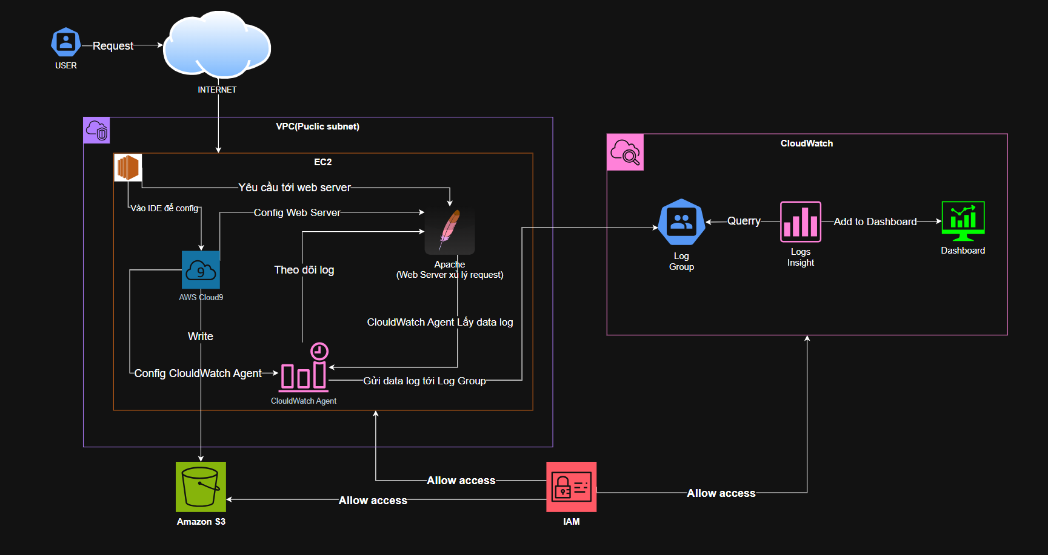
Architecture diagram of the solution
Notes:
Use the following resources to create a diagram of your application architecture:
AWS Architecture Icons at https://aws.amazon.com/architecture/icons. This page includes diagram assets as well as links to drawing and diagramming tools that you can use.
As you walk through the architecture, make sure that you relate back to the business requirements and the AWS Well-Architected Framework (https://docs.aws.amazon.com/wellarchitected/latest/framework/welcome.html).
You can also go more in depth about the design considerations and trade-offs that you made.

Slide 8
Lessons learned
Các thử thách đã vượt qua
- Cài đặt và cấu hình CloudWatch Agent gặp khó khăn ban đầu do thiếu quyền IAM hoặc cấu hình chưa đúng.
- Việc sử dụng AWS Cloud9 để thao tác với hệ thống Linux yêu cầu nắm rõ cấu trúc thư mục log và quyền truy cập.
- Kết nối và theo dõi log theo thời gian thực qua CloudWatch Logs Insights cần thời gian để hiểu rõ cú pháp truy vấn.
- Thao tác sao lưu log thủ công về Amazon S3 yêu cầu biết lệnh terminal và quyền truy cập đúng.
Notes:
Describe any challenges that you encountered and how you overcame those challenges.
For example: “I got stuck when I was creating an EC2 instance to host the application. I used the resources that were listed in the instructions to walk myself through the process to create a new EC2, and I was able to complete the task. The links to labs in other courses were very helpful.”
Describe any new skills that you learned from this project.
For example: “I learned how to set up auto scaling correctly so my resources were automatically adjusted and allocated at the lowest possible cost.”
Discuss any future, out-of-scope use cases in the next steps.
For example: “I would like to scale out the web application so that multiple departments can use it.”

Slide 9
Lessons learned
Nguồn tài liệu hữu ích
AWS Documentation
AWS Skill Builder Lab: Clickstream Analytics with Amazon CloudWatch
Stack Overflow & AWS re:Post
Hướng dẫn chính thức về CloudWatch, IAM, EC2, S3
…
Notes:
Describe any challenges that you encountered and how you overcame those challenges.
For example: “I got stuck when I was creating an EC2 instance to host the application. I used the resources that were listed in the instructions to walk myself through the process to create a new EC2, and I was able to complete the task. The links to labs in other courses were very helpful.”
Describe any new skills that you learned from this project.
For example: “I learned how to set up auto scaling correctly so my resources were automatically adjusted and allocated at the lowest possible cost.”
Discuss any future, out-of-scope use cases in the next steps.
For example: “I would like to scale out the web application so that multiple departments can use it.”

Slide 10
Lessons learned
Kỹ năng mới đã học được
Biết cách cài đặt và cấu hình CloudWatch Agent trên EC2
Sử dụng AWS Cloud9 để thao tác trực tiếp với hệ thống Linux
Truy vấn log với Logs Insights và trực quan hóa trên Dashboard
Sao lưu log vào Amazon S3
Thiết kế kiến trúc phân tích dữ liệu trên AWS
Notes:
Describe any challenges that you encountered and how you overcame those challenges.
For example: “I got stuck when I was creating an EC2 instance to host the application. I used the resources that were listed in the instructions to walk myself through the process to create a new EC2, and I was able to complete the task. The links to labs in other courses were very helpful.”
Describe any new skills that you learned from this project.
For example: “I learned how to set up auto scaling correctly so my resources were automatically adjusted and allocated at the lowest possible cost.”
Discuss any future, out-of-scope use cases in the next steps.
For example: “I would like to scale out the web application so that multiple departments can use it.”

Slide 11
Lessons learned
Kế hoạch sắp tới
Tự động hóa pipeline phân tích clickstream với Lambda, Kinesis hoặc Glue
Dùng Amazon Athena hoặc Redshift để phân tích dữ liệu nâng cao
Tích hợp báo cáo động với QuickSight cho ban quản lý
Bảo mật hơn: thêm cảnh báo log bất thường, dùng IAM chi tiết
Notes:
Describe any challenges that you encountered and how you overcame those challenges.
For example: “I got stuck when I was creating an EC2 instance to host the application. I used the resources that were listed in the instructions to walk myself through the process to create a new EC2, and I was able to complete the task. The links to labs in other courses were very helpful.”
Describe any new skills that you learned from this project.
For example: “I learned how to set up auto scaling correctly so my resources were automatically adjusted and allocated at the lowest possible cost.”
Discuss any future, out-of-scope use cases in the next steps.
For example: “I would like to scale out the web application so that multiple departments can use it.”

Slide 12
Thank you

